Slide 1
Amazon Sales Data
Power BI Project
By Pranjal Chavle

Slide 2

Table of Contents
Problem Statement
Variable Description
Introduction
Important KPS’s
Snapshots of Dashboard’s

Slide 3
Project : Analyzing Amazon Sales Data
Problem Statement:
Sales management has gained importance to meet increasing competition and the need for improved methods of distribution to reduce cost and to increase profits. Sales management today is the most important function in a commercial and business enterprise.
Do ETL: Extract-Transform-Load some Amazon dataset and find Sales-trend -> month-wise, year-wise, yearly-month-wise

Slide 4
Variable Description:
Region: The geographical area where the sales transaction took place (e.g., North America, Europe, Asia).
Country: The specific country within the region where the sales transaction occurred.
Item Type: The category or type of item sold (e.g., vegetables, clothing, Baby Food).
Sales Channel: The medium through which the sale was made (e.g., online, offline).
Order Priority: The priority level assigned to the order (e.g., high, medium, low), which might affect processing and shipping times.
Order Date: The date on which the order was placed by the customer.
Order ID: A unique identifier assigned to each order for tracking purposes.

Slide 5
Variable Description Continued:
Ship Date: The date on which the order was shipped to the customer.
Units Sold: The number of units of the item sold in the transaction.
Unit Price: The price per unit of the item sold.
Unit Cost: The cost incurred by Amazon for each unit of the item.
Total Revenue: The total revenue generated from the sale, calculated as Units Sold multiplied by Unit Price.
Total Cost: The total cost incurred for the sold units, calculated as Units Sold multiplied by Unit Cost.
Total Profit: The profit generated from the sale, calculated as Total Revenue minus Total Cost.

Slide 6
Introduction:
In today's competitive business world, where businesses must always look for superior distribution techniques to cut costs and enhance profits, sales management is becoming more and more important. Sales management is an essential role in commercial organizations that not only generates income but also guarantees the long-term viability and expansion of the company. Businesses may get important insights into their sales performance, spot trends, and make data-driven decisions to improve their strategies by utilizing data analytics and visualization tools like Power BI.

Slide 7



Important KPI’s:
Sales Trend Analysis
Profit by Sales Channels
Profit by Region
Unit Sold per Year
Unit Sold per Year-Month wise
Unit Sold by Region
Unit Sold by Item type
Unit Sold by Sales Channel
Unit Sold by Order Priority

Slide 8
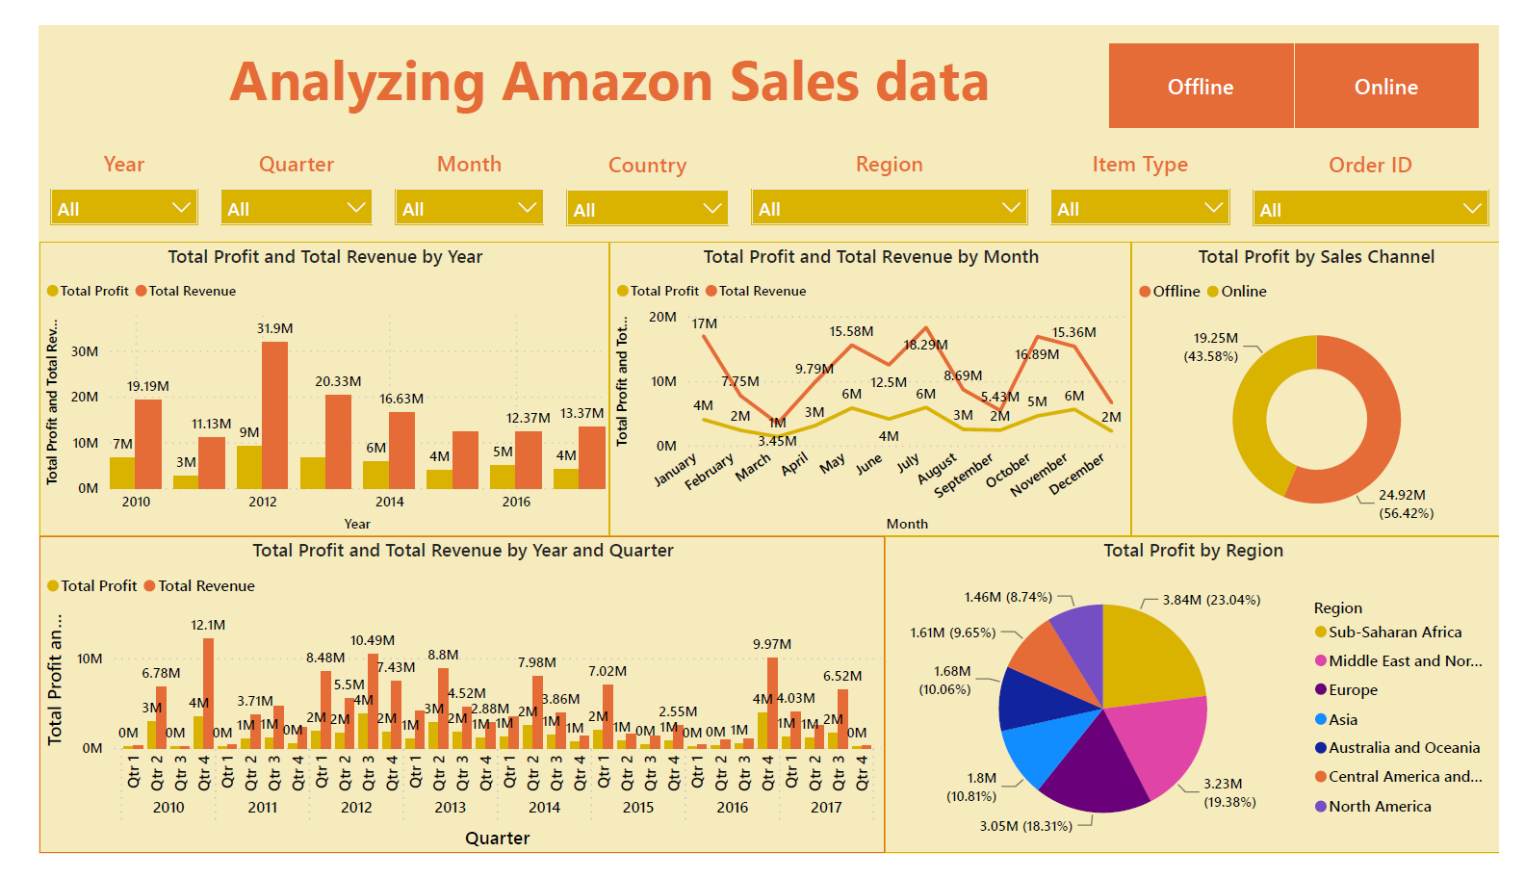
Dashboard Snapshots:

Slide 9
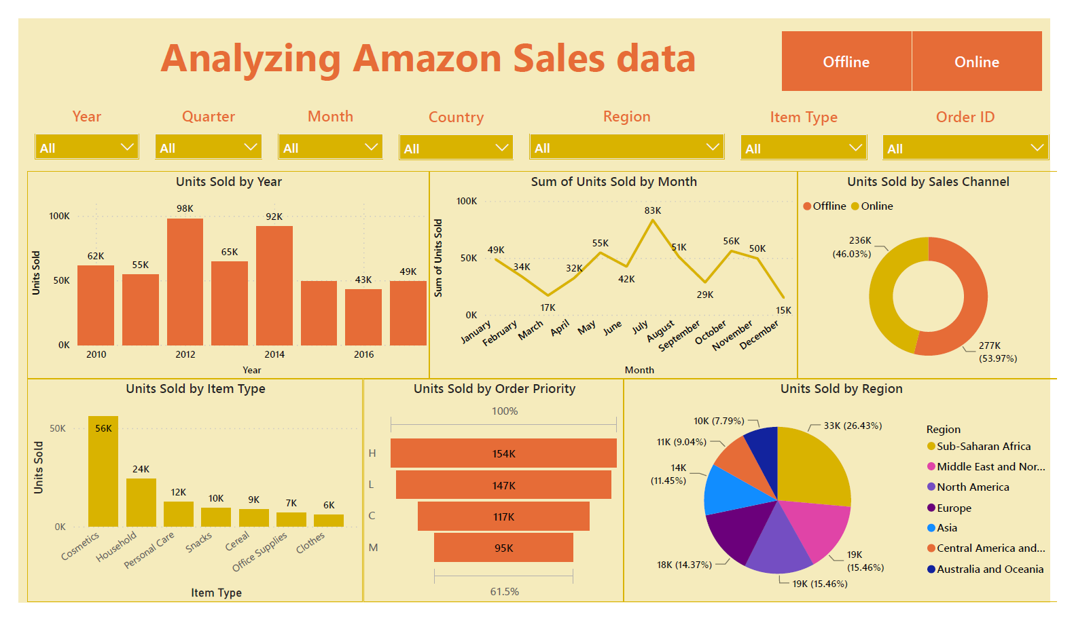
Dashboard Snapshots:

Slide 10
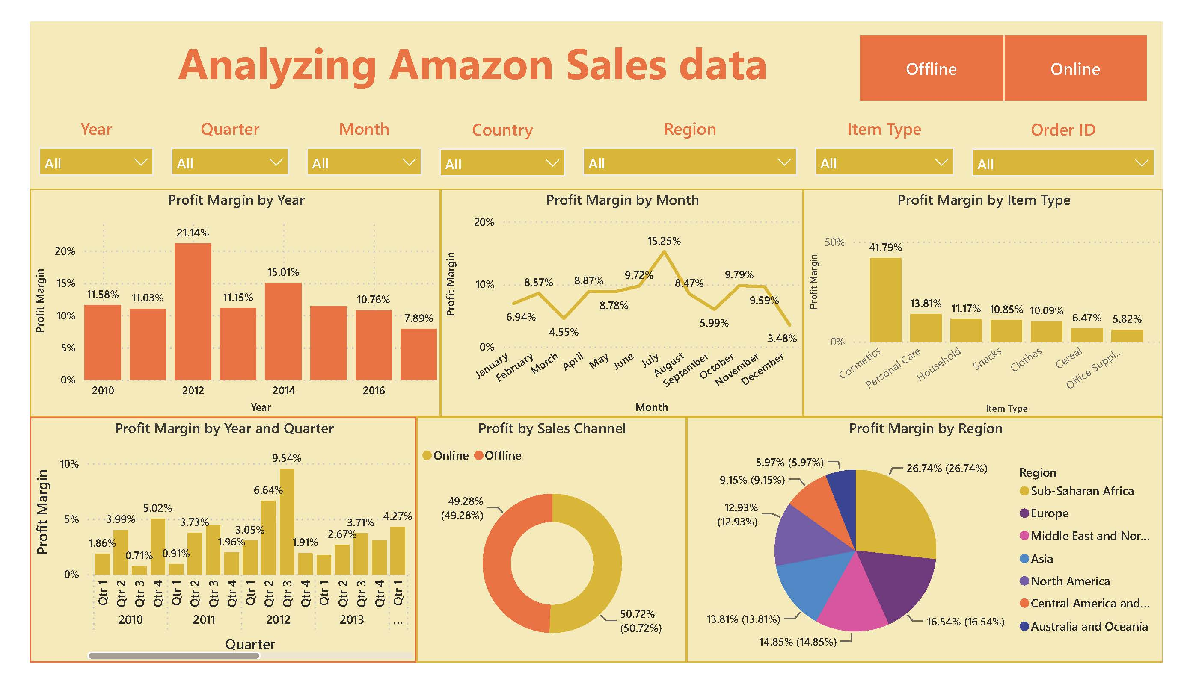
Dashboard Snapshots:

Slide 11


Thank You

